Slide 1
ZyoFiSik
Your Personal AI trainer

Slide 2
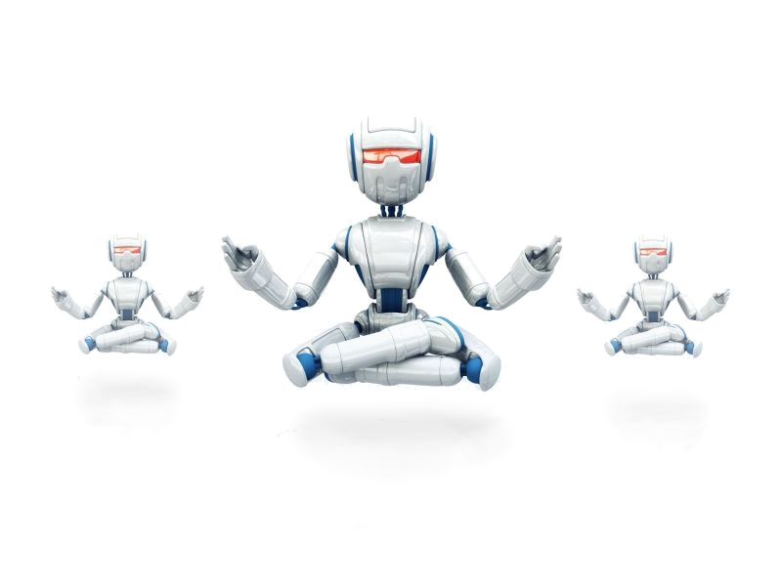
Domain - Artificial Intelligence

Slide 3
Co-ordinator &
Guide
Dr. L. Jaba Sheela
Angel F
211418104020
Bairavi B
211418104033
Team
ZyoFiSik
Jey Sneha A
211418104101
Batch A24

Slide 4
REVIEW I
Overview
Literature Survey
Problem Definition
Feasibility Study
System Architecture

Slide 5
Overview
The main goal of our project is to develop an interactive web application that uses a webcam to recognize the user's yoga and exercise poses and estimates each pose to assist the user practicing those postures to infer whether or not practiced effectively.
In the Yoga Assistant module, the CNN algorithm is deployed by using the Keras- Sequential Model that uses categorical cross entropy to calculate the loss function and adam optimizer to reduce the loss.

Slide 6
The Exercise Trainer module takes the frame from real-time webcam stream at specific intervals and gets all the keypoints using pose estimation algorithm from the BlazePose Model in MediaPipe.
In the Meditation Module the user specifies the duration of the meditation.Consequently, when the client seeks the server every half a second and checks for a change in the file name to switch its instruction, the server provides the audio file depending on the command at standard intervals such as breathe in, breathe out.

Slide 7
Literature survey
1)BASE PAPER: Yash Agrawal, Yash Shah, and Abhishek Sharma, (2020), “Implementation of Machine Learning Technique for Identification of Yoga Poses”, 9th IEEE International Conference on Communication Systems and Network Technologies, pp. 40-43
Six classification models of machine learning namely Logistic Regression, Random Forest, SVM, Decision Tree, Naive Bayes and KNN were tested.
But by using CNN and LSTM an accuracy of 99.04% was attained on a single frame when the Key Points were acquired via Open Pose.
Open Pose was used to acquire the Keypoints.
MediaPipe is faster because of its use of GPU.
Dataset- 10 yoga poses, each class containing around 400 to 900 images, and the compiled Colour Image dataset consists of 5459 images.
Overall 94.28% accuracy was attained of all machine learning models, with Random Forest producing the most accuracy of approx 99%.

Slide 8
2) Chhaihuoy Long, Eunhye Jo, and Yunyoung Nam, (2022), “Development of a yoga posture coaching system using an interactive display based on transfer learning” - J Supercomput 78, 5269–5284
This paper uses TL-MobileNet-DA through which they have achieved 98.43% accuracy.
Model is trained on 14 poses with a total of 120 images.
Performing data augmentation → sheer range of 0.2, zoom at 0.2, width shift and height shift in the range of 0.12, brightness at range [1, 1], and horizontal flip
Transfer learning (TL) is performed on six different pre-trained models, including VGG16, VGG19, MobileNet, MobileNetV2, InceptionV3, and DenseNet201, using the ImageNet dataset
This model uses the categorical cross-entropy loss function and Adam optimizer, with 100 epochs, in the training process
Min delta value of 0.001 at patience 10 on EarlyStopping.

Slide 9
3) Nagalakshmi Vallabhaneni and Dr. P. Prabhavathy, (2021), “The Analysis of the Impact of Yoga on Healthcare and Conventional Strategies for Human Pose Recognition”, Turkish Journal of Computer and Mathematics Education. (TURCOMAT).,vol. 12 no. 6, pp. 1772–1783,
Yoga is perhaps the most straightforward physical, mental, and Spiritual work during this isolation period.
Yoga Practice deals with these psychological issues, and along with breathing, meditation is the best general practice that will be careful with our body, brain, and soul.
Yoga's impact on the people in the lockdown period is analyzed.
The data was collected from 109 people, including 64 people who are male and 45 are female.
Five parameters are considered: stress level, peace of mind, consciousness, physical health, and the respondent's mental health.

Slide 10
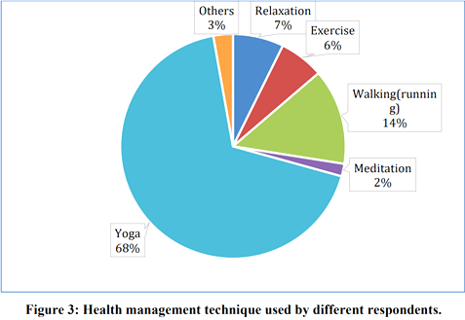
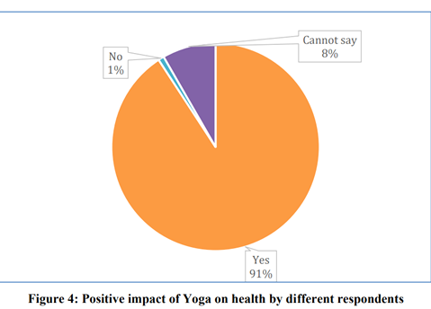
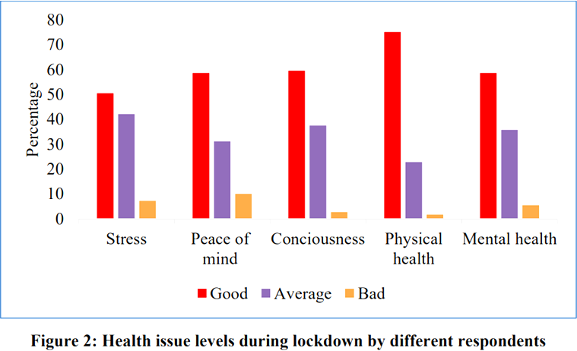

Slide 11
4) Wu, Y., Lin, Q., Yang, M., Liu, J., Tian, J., Kapil, D.P., & Vanderbloemen, L. (2021). “A Computer Vision-Based Yoga Pose Grading Approach Using Contrastive Skeleton Feature Representations.” Healthcare (Basel), 10(1):36
The objective of this yoga pose grading approach was to input two yoga pose images from the learner and the coach, respectively, and then extract the human skeleton key points and calculate the feature similarity between them
This system used both the coarse triplet example and the fine triplet example
Mediapipe framework is used to extract the key points.
Yoga pose classification image dataset adopted from Kaggle with 45 categories and 1931 images are selected. Gave accuracy of 83.21%
Yoga pose grading image dataset constructed by the authors containing 3000 triplet examples with each triplet example consisting of three pose images that belong to the same yoga pose category produced 63.58% accuracy.

Slide 12
5) Deepak Kumar, and Anurag Sinha, (2020), “Yoga Pose Detection and Classification Using Deep Learning” International Journal of Scientific Research in Computer Science, Engineering and Information Technology, Volume 6 Issue 6 Page: 160-184
Keypoint Extraction of the human joint areas are done utilizing OpenPose.
The system works at rate of 3 FPS(frames per second).
Dataset: It comprises of recordings of 6 yoga asanas performed by 15 distinct people (5 females and 10 guys) containing a total of 88 recordings (rate=30 FPS).
Uses Support Vector Machine(SVM) algorithm which is best suited for classification.
Train precision: 0.9953 Validation exactness: 0.9762 Test precision: 0.9319
CNN outperforms the SVM in terms of testing accuracy.(Train exactness: 0.9878 Validation precision: 0.9921 Test precision: 0.9858 )
The Paper uses OpenPose with 18 key points of 2D pose and gives accuracies as mentioned above.

Slide 13
6) Girija Gireesh Chiddarwar, Abhishek Ranjane, Mugdha Chindhe, Rachana Deodhar, and Palash Gangamwar, (2020), “AI-Based Yoga Pose Estimation for Android Application” International Journal of Innovative Science and Research Technology, Volume 5 - Issue 9
This paper surveys the various technologies that can be used for pose estimation and concludes the best method based on the usability for an android application.
Methodology: This paper ponders Pose Estimation models like OpenPose, DeepPose, and PoseNet.
OpenPose- Realtime Multi-Person 2D Pose Estimation using Part Affinity Fields(approach for relationship between body parts).
Con:The issue with OpenPose is that it necessitates specialized hardware and does not scale well on mobile devices.

Slide 14
DeepPose- This model makes use of deep learning models, yet it performs poorly due to weak generalisation.
PoseNet- This paper endorses the PoseNet model as it is an open-sourced technology that allows us to extract the 17 essential points natively and a skeleton of the human pose is drawn with the help of these points, which is then used to derive angles between these points thus enabling us to effectively correct the user’s yoga poses. It is deployed using Tensorflow.
Con: The Pose net model only returns 17 key points, none of which includes fingers, which could lead to hand position modifications being limited.

Slide 15
7) M. Verma, S. Kumawat, Y. Nakashima and S. Raman, (2020), "Yoga-82: A New Dataset for Fine-grained Classification of Human Poses", IEEE/CVF Conference on Computer Vision and Pattern Recognition Workshops (CVPRW) pp. 4472-4479
Yoga82 consists of 82 complex yoga pose images downloaded from web using the Bing search engine.
Both Sanskrit and English names of yoga poses were used to search for images and the downloaded images were cleaned and annotated manually.
Every image contains one or more people doing the same yoga pose. Furthermore, images have poses captured from different camera view angles.
The dataset has a varying number of images in each class from 64 (min.) to 1133 (max.) with an average of 347 images per class
Some of the images are downloaded from a specific yoga website. Hence, they contain only yoga pose with clean background. However, there are many images with random backgrounds

Slide 16
8) Nuruldelmia Idris, Cik Feresa Mohd Foozy, and Palaniappan Shamala, (2020), “A Generic Review of Web Technology: DJango and Flask”, International Journal of Advanced Computing Science and Engineering ISSN 2714-7533 Vol. 2, No. 1
Django comes with a comprehensive MVC Framework that takes care of everything. While Django may be used to create a RESTful API on its own, it is one of the frameworks that sows fantastical creations. It is a feature-rich extension of the Django framework. On the other hand, Flask is a micro-framework that adheres to a set of rules: complete one task at a time effectively. It provided very little upfront, but it has a significant number of extensions that match Django's feature set.
Versioning – Django's flexibility makes the task less critical and multiple URL formats are supported and can be sent in as a request parameter.

Slide 17
Browsable API – Django Generates HTML pages to browse and execute all the endpoints where the users or developers can operate swiftly and simply.
Regular releases - the news version is always released twice a year to keep users up to date with the newest edition.
Speed – Flask is generally fast in performance compared to Django which might be due to Flask's simplistic design as it can handle hundreds of queries per second without slowing down the process.
NoSQL support –Flask is compatible with NoSQL databases such as MongoDB and DynamoDB.

Slide 18
9) Camillo Lugaresi, Jiuqiang Tang, Hadon Nash, Chris McClanahan, Esha Uboweja, Michael Hays,Fan Zhang, Chuo-Ling Chang, Ming Guang Yong, Juhyun Lee, Wan-Teh Chang, Wei Hua,Manfred Georg and Matthias Grundmann, (2019), “MediaPipe: A Framework for Perceiving and Processing Reality”, Computer Vision for AR/VR at IEEE Computer Vision and Pattern Recognition (CVPR).
Mediapipe is a cross-platform library developed by Google that provides ready-to-use customizable ML solutions for live and streaming media,for computer vision tasks.
ALTERNATIVES TO MEDIAPIPE -ARKit3,Microsoft Mixed Reality Toolkit,OpenPose
ARKit 3 Body Tracking
Problem:Several false positives similar to the ones in the picture, e.g.shadows on the walls, painting decorations being mistakenly identified as humans.
Microsoft Mixed Reality Toolkit
Problem: The SDK was an abstraction for the capabilities of the different platforms not suitable for all platforms

Slide 19
OpenPose
Problem:It is based on DNN which requires a high-end computer Slight tradeoff between speed and accuracy.
Current human pose performance metrics are based on keypoint accuracy
Failure cases still exist(foot and leg occluded, rare joint position)
Google MediaPipe
The accuracy of the solution was very high.
MediaPipe is Fast is able to achieve its speed by the use of GPU acceleration and multi-threading.
Mediapipe is Modular and Reusable- Mediapipe’s use of graphs, subgraphs, and calculators means that the work of one project can easily translate to the work of another.
Mediapipe is Deployment Platform Friendly - you can deploy your application not only to desktops but to mobile devices as well.

Slide 20
10) T. K. K. Maddala, P. V. V. Kishore, K. K. Eepuri and A. K. Dande, (2019), "YogaNet: 3-D Yoga Asana Recognition Using Joint Angular Displacement Maps With ConvNets," IEEE Transactions on Multimedia, vol. 21, no. 10, pp. 2492-2503, Oct. 2019
Performed by integrating joint angular movements along with the joint distances in a spatiotemporal color-coded image called a joint angular displacement map(JADM)
JADMs are trained with a single-stream CNN
Steps ⇒ Compute JADMs from 3D data → Color code the JADMs → Train and test the CNN.
A single 3D skeleton with J joints, there will be J×(J−1) / 2 unique joint pairs
Dataset prepared contains a total of 4200 3D yoga videos recorded for 42 poses and 100 variations per pose.
Model consisting eight convolutional layers followed by two fully connected layers produced a accuracy of 90.01

Slide 21
11) Chen, H., He, Y., & Hsu, C., (2018), “Computer-assisted yoga training system”, Multimedia Tools and Applications, 77, 23969-23991.
A computer vision-based yoga training system, termed Y-system, to analyze the postures of a practitioner and assist in rectifying incorrect postures.
This system analyzes up to twelve yoga poses
Topological skeletons are generated from the practitioner’s body maps of front and side views
Then, the Y-system extracts postural features including dominant axes, skeleton-based feature points, and contour based feature points
A distance map is produced by applying distance transform to the body map
Explicit posture description models for the 12 yoga poses based on their respective training is implemented
The accuracy of Y-system for each pose ranges from 76.22% to 99.87%

Slide 22
Problem Statement
Yoga and Exercise have become ineluctable for the health and relaxation of the multitude as a result of the rise in stress in modern living. Asanas can be learned in a yoga studio or at home with home instructions or self-taught with the help of books and videos, where self-learning is the most desired option, especially in this pandemic crisis, but certainly is the most daunting as well. The possibility to practice it incorrectly is high, which ultimately is futile. Therefore, our system helps the practitioners to perceive whether or not it is an asset to their fitness routine instead of stalling their time and effort.

Slide 23
Social Feasibility
Yoga aims at the development of all-round personality, it is the synchronization of mind, body, and spirit.
Yoga can result in serious damage to one’s physique and brain if not performed correctly. Hence it demands proper training and assistance during the course of action.
In ancient times, it used to be performed only under the supervision of an accomplished Guru (teacher). Therefore, it is essential to adopt the right Yoga procedure at the very beginning.
Deep Learning models can be trained to detect Yoga postures and be able to provide feedback/corrections if needed and conveys if the pose performed in the image is correct.

Slide 24
Economical Feasibility
Economical Feasibility study using COCOMO model was carried out to find the cost/ benefits analysis of the project .
Advanced COCOMO model with organic,semi-detached categories of software project modelling is used.
MODULE | CATEGORY | EFFORT (PM) | DEVELOPMENT TIME (Months)
MEDITATION | ORGANIC | 3.2(KLOC)1.05 | 2.5(Effort)0.38
EXERCISE | SEMI-DETACHED | 3.0(KLOC)1.12 | 2.5(Effort)0.35
YOGA POSE ESTIMATION | SEMI-DETACHED | 3.0(KLOC)1.12 | 2.5(Effort)0.35

Slide 25
Meditation:
Estimation of development effort:
Effort = 3.2(KLOC)1.05 PM = 3.2(0.15)1.05 = 3.2 x 0.1364 =0.43 PM
Estimation of development time:
Tdev = 2.5(Effort)0.38 Months = 2.5(0.43)0.38 = 2.5 x 0.7256 =1.81 Months
Exercise
Effort Adjustment Factor EAF = 1
Estimation of development effort:
Effort = 3.0(KLOC)1.12 PM = 3 x 0.3583 = 1.07 PM
Estimation of development time:
Tdev = 2.5(Effort)0.35 Months = 2.5 x 1.025 = 2.56 Months

Slide 26
Pose estimation
Effort Adjustment Factor EAF = 1
Estimation of development effort:
Effort = 3.0(KLOC)1.12 PM = 3 x 0.2596= 0.77 PM
Estimation of development time:
Tdev = 2.5(Effort)0.35 Months = 2.5 x 0.9162= 2.29 Months
Total effort = 0.43+1.07+0.77 = 2.27 PM
Total development time = 1.81 + 2.56+2.29 = 6.6 Months

Slide 27
Technical Feasibility
Python:
Since this is an artificial intelligence project using python gives us the advantage for various inbuilt libraries like TensorFlow, Scikit-Learn, and NumPy.
Python is an object-oriented programming language that makes coding easier and less prone to syntax errors.
Python being platform-independent will help in future up-gradation to deploy as software.
Flask:
The two mostly used web frameworks are flask and django with Flask being a lightweight framework.
This project is deployed in HEROKU, which has limits to the size of the compressed file thus we made use of flask to reduce the lines of code also flask is best suited for SINGLE APPLICATIONS.

Slide 28
MediaPipe:
Mediapipe Human Pose Detection solution provides 33 key points each containing x,y,z coordinates along with the visibility score. The solution utilizes a two-step detector-tracker ML pipeline.
Using a detector, the pipeline first locates the person/pose region-of-interest (ROI) within the frame. The tracker subsequently predicts the pose landmarks and segmentation mask within the ROI using the ROI-cropped frame as input.BlazePose accurately localizes more key points, making it uniquely suited for fitness applications.
CNN:
CNN a supervised learning model has given satisfactory results in identifying key features of the training data.
Yoga-82 Dataset :
It contains 82 classes of images with each yoga class containing an average of 200 images.
The dataset is labeled with 3 levels of hierarchy and is obtained from the Internet.

Slide 29
Resource Feasibility
HEROKU
TENSORFLOW
MEDIAPIPE
COLAB
YOGA-82 DATASET
AND KERAS
Free Cloud PaaS Platform and ecosystem.
Free Open-source software libraries.
Google’s Free Python Development environment
Google’s Free Open-source framework
Free, Open Data Set
Developers can build, deploy, and run apps for free using a full range of free cloud services through the Heroku platform which makes it a viable option.
The python libraries are an asset to the model and them being open source makes it appropriate.
Since the machine learning framework developed by google is free it apparently makes it a pragmatic option
We make use of it to train the model and it being free makes it a realistic option
Since the dataset is obtained online it makes it a feasible option.

Slide 30
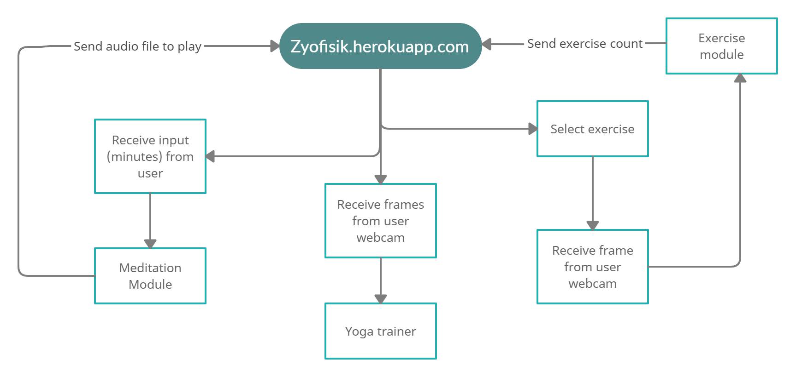
System Architecture
UI Module

Slide 31
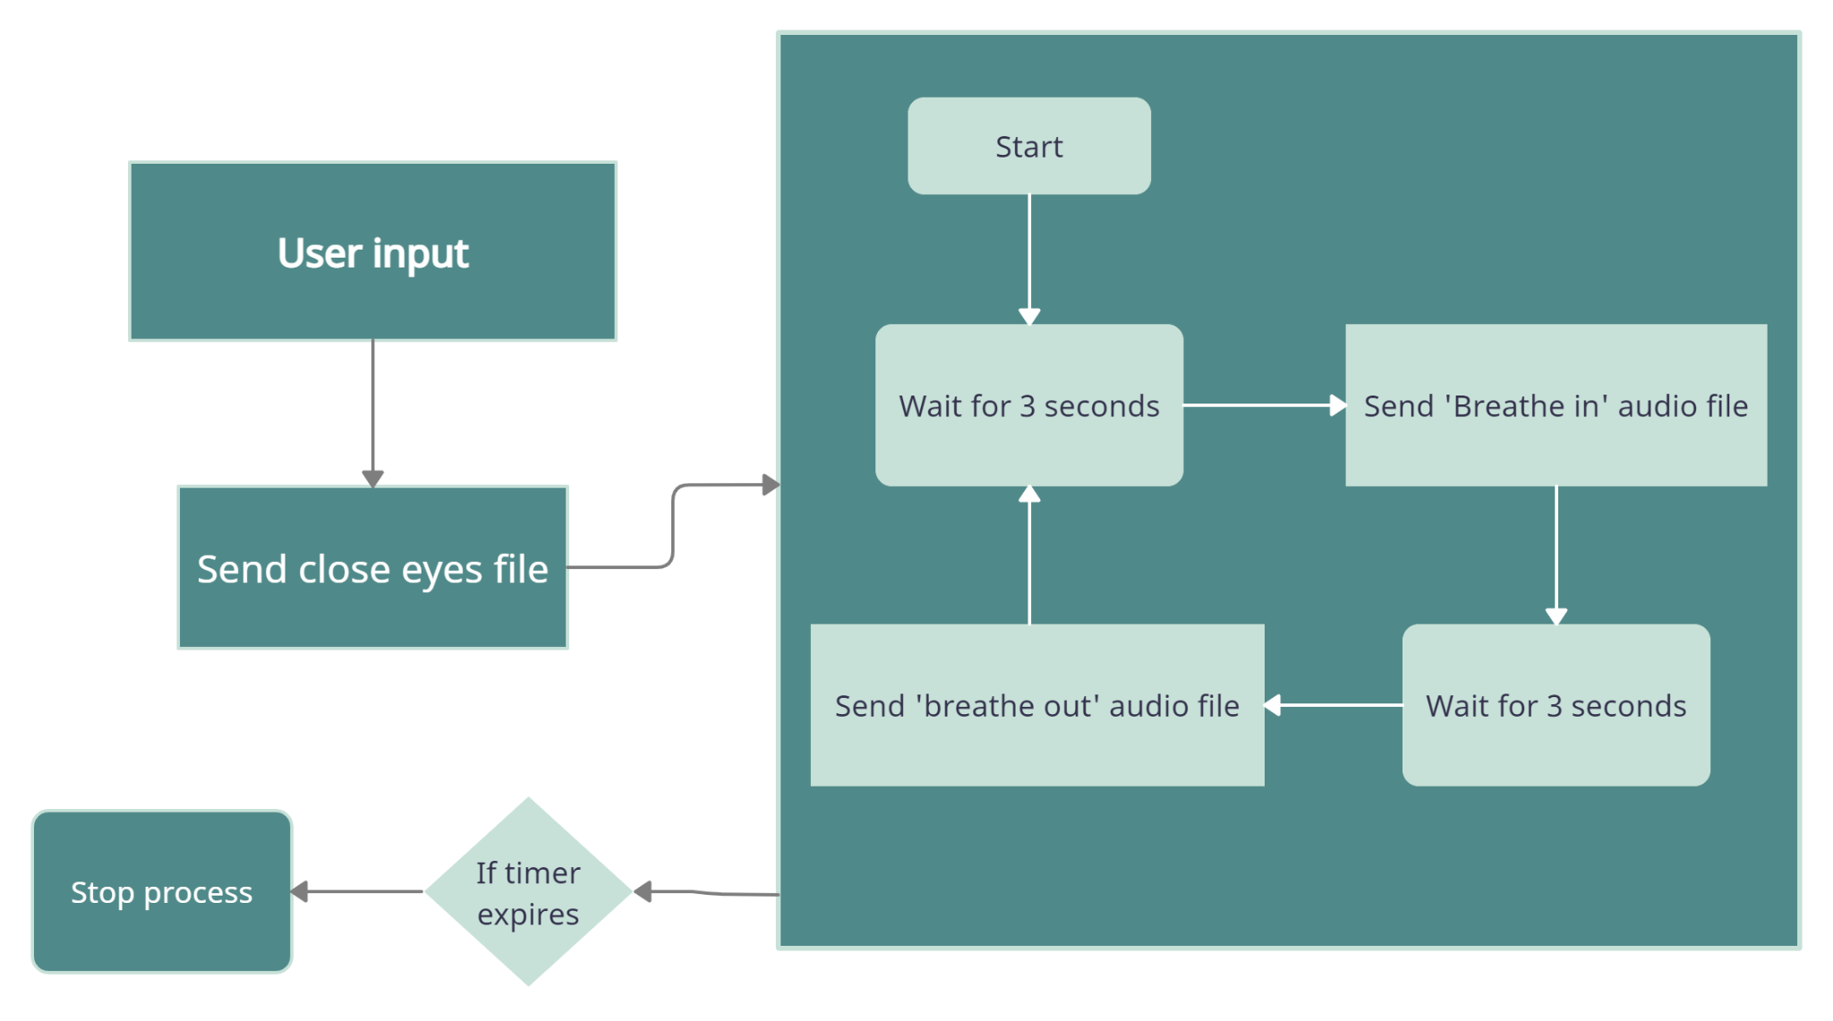
Meditation module

Slide 32
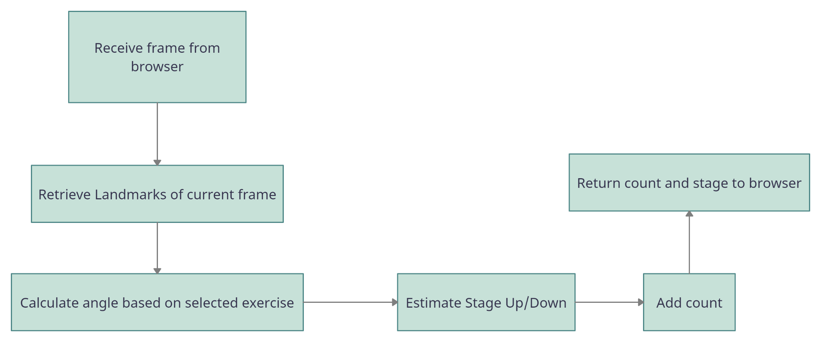
Exercise Module

Slide 33
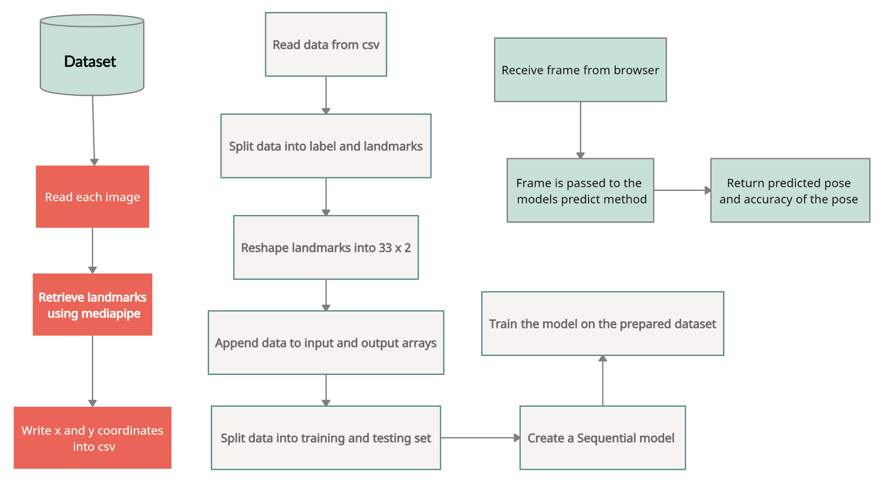
Yoga Trainer

Slide 34
References
BASE PAPER ⇒ Yash Agrawal, Yash Shah, and Abhishek Sharma, (2020), “Implementation of Machine Learning Technique for Identification of Yoga Poses”, 9th IEEE International Conference on Communication Systems and Network Technologies, pp. 40-43
DOI: 10.1109/CSNT48778.2020.9115758
Chhaihuoy Long, Eunhye Jo, and Yunyoung Nam, (2022), “Development of a yoga posture coaching system using an interactive display based on transfer learning” - J Supercomput 78, 5269–5284
DOI: 10.1007/s11227-021-04076-w

Slide 35
Nagalakshmi Vallabhaneni and Dr. P. Prabhavathy, (2021), “The Analysis of the Impact of Yoga on Healthcare and Conventional Strategies for Human Pose Recognition”, Turkish Journal of Computer and Mathematics Education(TURCOMAT).,vol. 12 no. 6, pp. 1772–1783,
DOI: 10.17762/turcomat.v12i6.4032
Wu, Y., Lin, Q., Yang, M., Liu, J., Tian, J., Kapil, D.P., & Vanderbloemen, L. (2021). “A Computer Vision-Based Yoga Pose Grading Approach Using Contrastive Skeleton Feature Representations.” Healthcare (Basel), 10(1):36
DOI: 10.3390/healthcare10010036
Deepak Kumar, and Anurag Sinha, (2020), “Yoga Pose Detection and Classification Using Deep Learning” International Journal of Scientific Research in Computer Science, Engineering and Information Technology, Volume 6 Issue 6 Page: 160-184
DOI: 10.32628/CSEIT206623

Slide 36
Girija Gireesh Chiddarwar, Abhishek Ranjane, Mugdha Chindhe, Rachana Deodhar, and Palash Gangamwar, (2020), “AI-Based Yoga Pose Estimation for Android Application” International Journal of Innovative Science and Research Technology, Volume 5 - Issue 9
DOI: 10.38124/IJISRT20SEP704
M. Verma, S. Kumawat, Y. Nakashima and S. Raman, (2020), "Yoga-82: A New Dataset for Fine-grained Classification of Human Poses", IEEE/CVF Conference on Computer Vision and Pattern Recognition Workshops (CVPRW) pp. 4472-4479
DOI: 10.1109/CVPRW50498.2020.00527
Nuruldelmia Idris, Cik Feresa Mohd Foozy, and Palaniappan Shamala, (2020), “A Generic Review of Web Technology: DJango and Flask”, International Journal of Advanced Computing Science and Engineering ISSN 2714-7533 Vol. 2, No. 1
DOI: 0.30630/ijasce.2.3.29

Slide 37
Camillo Lugaresi, Jiuqiang Tang, Hadon Nash, Chris McClanahan, Esha Uboweja, Michael Hays,Fan Zhang, Chuo-Ling Chang, Ming Guang Yong, Juhyun Lee, Wan-Teh Chang, Wei Hua,Manfred Georg and Matthias Grundmann, (2019), “MediaPipe: A Framework for Perceiving and Processing Reality”, Computer Vision for AR/VR at IEEE Computer Vision and Pattern Recognition (CVPR).
T. K. K. Maddala, P. V. V. Kishore, K. K. Eepuri and A. K. Dande, (2019), "YogaNet: 3-D Yoga Asana Recognition Using Joint Angular Displacement Maps With ConvNets," IEEE Transactions on Multimedia, vol. 21, no. 10, pp. 2492-2503, Oct. 2019,
DOI: 10.1109/TMM.2019.2904880
Chen, H., He, Y., & Hsu, C., (2018), “Computer-assisted yoga training system”, Multimedia Tools and Applications, 77, 23969-23991.
DOI: 10.1007/s11042-018-5721-2

Slide 38
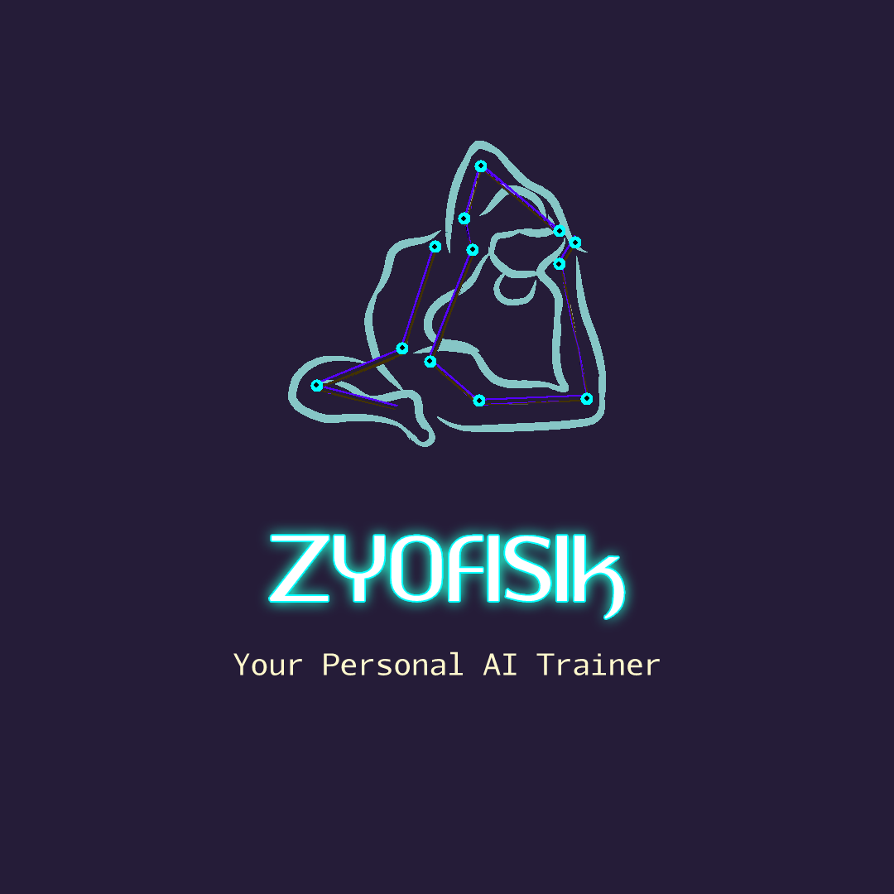

Slide 39

Thank You !!!
- ZyoFiSik

